Slide 1

Data Structures (15B11CI311) Odd Semester 2021
3rd Semester , Computer Science and Engineering
Jaypee Institute Of Information Technology (JIIT), Noida

Slide 2
Outline
Different Searching Techniques:
Median search
Interpolation Search

Slide 3
Median Search
Let us define the median of N numerical values by:
The median of a list of N values is found by sorting the input array in increasing order, and taking the middle value. This will take O(nlogn) time in average/best case.
Example:
input values: 19 10 84 11 23 median: 19 The first definition is easy to grasp but is given through an algorithm (sort the array, take the central value), which is not the best way to define such a concept.
Finding the kth element in the array also required to sort the array first then select the kth element.
This also takes running time more than linear-time.
We want to find some algorithm that finds the median element in a linear time. The latter definition is more interesting since it leaves out the choice of the algorithm.

Slide 4
Median Search
Using this algorithm you can find out median as well as kth smallest element.
S is a list of numerical values and k is the rank of the kth smallest element in S. procedure select(k,S) if |S|=1 then return single element in S else choose an element ‘a’ randomly from S; let S1, S2, S3 be the sequences of elements in S respectively less, equal to, and greater than a; if (|S1| >= k) then return select(k,S1); else if (|S1|+|S2| >= k) then return a; else return select(k-|S1|-|S2|, S3);
Source: https://blog.51cto.com/wintys/102975

Slide 5
Example:
7 | 10 | 4 | 3 | 20 | 15 | 8 | 12 | 6
Find the k=4th median
randomly choose an element a = 10
Now divide the array into three part S1, S2, S3
S1= {7,4,3,8,6}
S2={10}
S3={20,15,12}
Now length of (S1)>=k=5>4 first condition true select(4,S1)
Check in the array S1={7,4,3,8,6}
Randomly choose element a=3
Now divide the array S1 into three parts S11,S12,S13
S11={}
S12={3}
S13={7,4,8,6}
Here first and second condition fail third condition true select(3,S13)

Slide 6
Here k=3
S13= {7,4,8,6}
Randomly choose a=7
Now divide S13 into three parts such as: S131,S132,S133
S131={4,6}
S132={7}
S133={8}
Here condition 1 fail
Condition 2 true
Length(S1)+length(S2)>=K 3==3
Return median a =7

Slide 7
Exercise:
Apply median search on the following array and find the 5th median.
14 | 2 | 7 | 11 | 56 | 47 | 28 | 6 | 3 | 10

Slide 8

Recursive Implementation
include<iostream>
using namespace std;
int median(int A[],int l,int r,int k)
{
int ind = r-l+1;
int index = rand() % ind;
int i,j=0,m=0,n=0;
int S1[10],S3[10],S2[1];
for(i=0;i<=r;i++)
{
if(A[i]<A[index])
{
S1[j]=A[i];
j++;
}
else if(A[i]==A[index])
{
S2[n]=A[i];
n++;
}
else
{
S3[m]=A[i];
m++;
} }
if(j>=k)
{
median(S1,0,j-1,k);
}
else if((j+n)>=k)
return A[index];
else
median(S3,0,m-1,k-(j+n));
}
// Driver program to test above methods
int main()
{
int arr[] = {7, 10, 4, 3, 20, 15, 8, 12,6};
int n = sizeof(arr)/sizeof(arr[0]), k = 4;
int element=median(arr, 0, n-1, k);
cout << "K'th smallest element is "<<element;
return 0;
}

Slide 9
Non-Recursive Implementation
Exercise: implement the non-recursive implementation of median search algorithm.

Slide 10
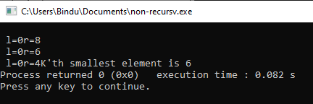
include<iostream>
using namespace std;
int median(int A[],int l,int r,int k)
{
int index, flag=0;
while(l<r)
{
int ind = r-l+1;
cout<<"\n l="<<l<<"r="<<r;
index = rand()%ind;
int i,j=0,m=0,n=0;
int S1[10],S3[10],S2[1];
for(i=0;i<=r;i++)
{
if(A[i]<A[index])
{
S1[j]=A[i];
j++;
}
else if(A[i]==A[index])
{
S2[n]=A[i];
n++;
}
else
{
S3[m]=A[i];
m++;
}
}
// j=j-1;m=m-1;
if(j>k)
{
for(int y=0;y<j;y++)
{
A[y]=S1[y];
r=j-1;
}
}
else if((j+n)>=k)
{
return A[index];
}
else
{
for(int y=0;y<m;y++)
{
A[y]=S3[y];
r=m-1;
k=k-(j+n);
}
}
}
}
int main()
{
int arr[] = {7, 10, 4, 3, 20, 15, 8, 12,6};
int n = sizeof(arr)/sizeof(arr[0]), k = 3;
int element=median(arr, 0, n-1, k);
cout << "K'th smallest element is "<<element;
return 0;
}

Slide 11
Interpolation Search
An Interpolation Search is an improvement over Binary Search for scenarios where the values in a sorted array are uniformly distributed.
Binary Search goes to the middle element to check.
On the other hand, Interpolation Search may go to different locations according to the value of the key being searched.
For example, if the value of the key is close to the last element, Interpolation Search is likely to start search toward the end side.
https://medium.com/karuna-sehgal/an-explanation-of-interpolation-search-c98555005138

Slide 12
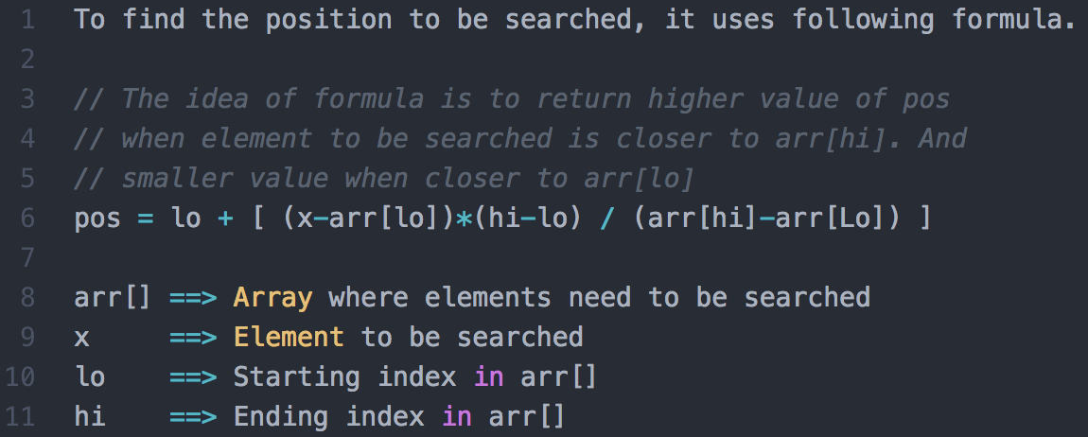

Slide 13
In a loop, calculate the value of “pos” using the probe position formula
If there is a match, return the index of the item, and exit.
If the item is less than the arr[pos], calculate the probe position of the left sub-array. Otherwise calculate the same in the right sub-array.
Repeat until a match is found or the sub-array reduces to zero.

Slide 14
int interpolationSearch(int arr[], int lo, int hi, int x)
{
int pos;
// Since array is sorted, an element present in array must be in range defined by corner
if (lo <= hi && x >= arr[lo] && x <= arr[hi]) {
pos = lo+ (((double)(hi - lo) / (arr[hi] - arr[lo])) * (x - arr[lo]));
if (arr[pos] == x)
return pos;
// If x is larger, x is in right sub array
if (arr[pos] < x)
return interpolationSearch(arr, pos + 1, hi, x);
// If x is smaller, x is in left sub array
if (arr[pos] > x)
return interpolationSearch(arr, lo, pos - 1, x);
}
return -1;
}

Slide 15
// Driver Code
int main()
{
int arr[] = { 10, 12, 13, 16, 18, 19, 20, 21,
22, 23, 24, 33, 35, 42, 47 };
int n = sizeof(arr) / sizeof(arr[0]);
// Element to be searched
int x = 18;
int index = interpolationSearch(arr, 0, n - 1, x);
// If element was found
if (index != -1)
cout << "Element found at index " << index;
else
cout << "Element not found.";
return 0;
}
Output:
Element found at index 4
Source: https://www.geeksforgeeks.org/interpolation-search/

Slide 16
https://www.techiedelight.com/find-kth-largest-element-array

